Slide 1
One hidden layer
Neural Network
Random Initialization

Slide 2




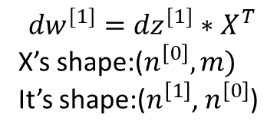

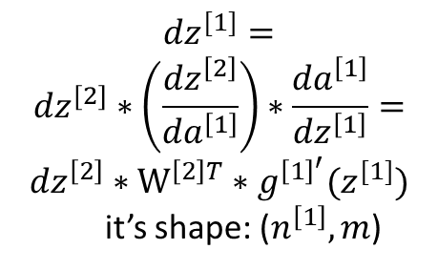

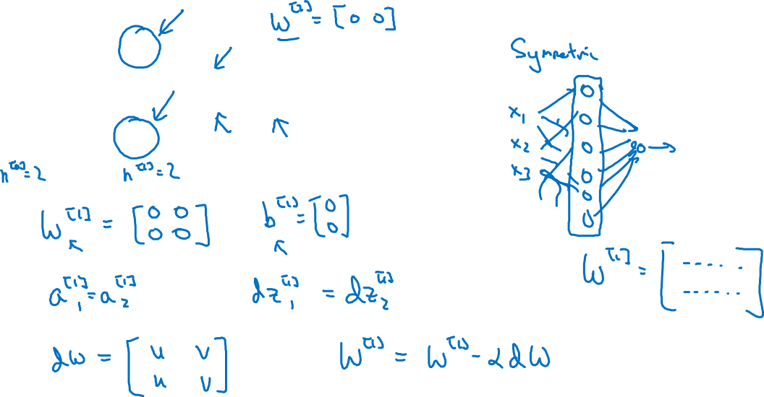
What happens if you initialize weights to zero?
$$x_{1}$$
$$a_{1}^{[1]}$$
$$a_{1}^{[2]}$$
$$\hat{y}$$
$$x_{2}$$
$$a_{2}^{[1]}$$
$${dz}^{[1]}=$$
$${dz}^{[2]}∗\left(\frac{{dz}^{\left[2\right]}}{{da}^{\left[1\right]}}\right)∗\frac{{da}^{\left[1\right]}}{{dz}^{\left[1\right]}}=$$
$${dz}^{\left[2\right]}∗W^{\left[2\right]T}∗g^{{\left[1\right]}^{′}}(z^{[1]})$$
it’s shape: ($n^{\left[1\right]}, m$)
$${dw}^{[1]}={dz}^{[1]}∗X^{T}$$
X’s shape:($n^{\left[0\right]},m)$
It’s shape:($n^{\left[1\right]}$, $n^{\left[0\right]}$)
Why symmetry is retained in dw?
Initialize w with all zero is not ok,
But initialize b with all zero is fine.

Slide 3
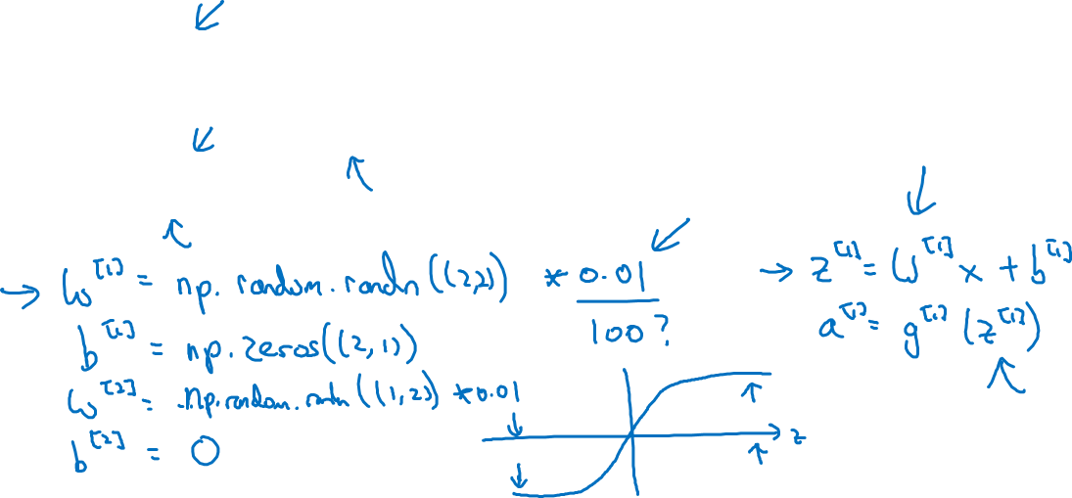
Random initialization
$$x_{1}$$
$$a_{1}^{[1]}$$
$$a_{1}^{[2]}$$
$$\hat{y}$$
$$x_{2}$$
$$a_{2}^{[1]}$$

